Slide 1
Lifestyle Disease’s

Slide 2
Heart Disease Facts
Leading cause of death in the United States for adults
1 in 4 adults are ill with a form of this disease.
Heart disease develops slowly over a lifetime.

Slide 3
What is the difference between heart disease and cardiovascular disease?
Heart disease refers to the heart.
Cardiovascular disease refers to the heart AND blood vessels.

Slide 4
Arteriosclerosis
Arteriosclerosis means hardening of the arteries.
Accumulation of soft fat on the inner walls of the arteries.
Cuts off nutrients and oxygen.
Also leads to high blood pressure.

Slide 5
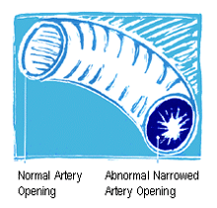

Slide 6
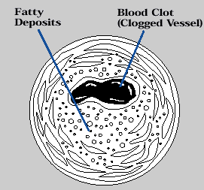
Blood Clots
Occurs when platelets begin to clot the plaque that has formed on the artery walls
Some clots begin to travel in the blood stream until they become caught in an area they cannot pass through.

Slide 8
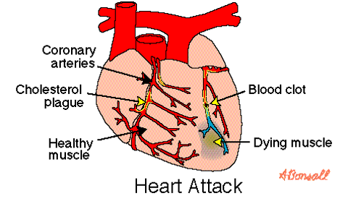
Heart Attack
When there is blockage in the arteries located in the heart.

Slide 9
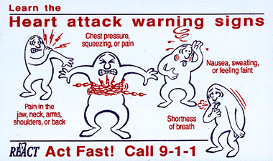

Slide 10
Stroke
Clot/blockage in the vessels that feed the brain vital nutrients and oxygen.

Slide 11
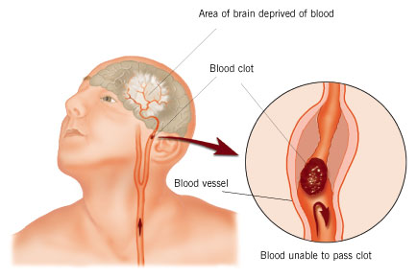
STROKE

Slide 12
He died of massive stroke at age 45 on 4/6/06: Heredity, weight gain , & stress probably played a significant role.

Slide 13
F.A.S.T Time: 2-3 hour window to get clot bursting drug to stand the best chance of full recovery.

Slide 14
Embolism
Clot breaks loose “traveling clot” reaches artery to small and suddenly blocks the vessel

Slide 15
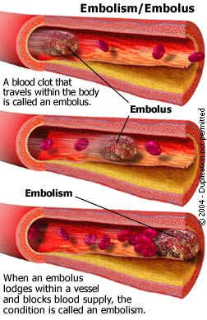

Slide 17
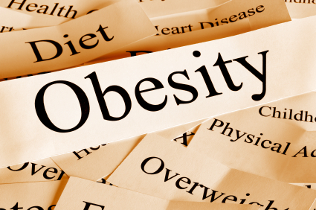
Body Mass Index (BMI): a measure of an adult’s weight in relation to his or her height, specifically the adult’s weight in kilograms divided by the square of his or her height in meters
Obesity- having a very high amount of body fat in relation to lean body mass, or Body Mass Index (BMI) of 30 or higher.

Slide 18
Obesity Is Related to Many Chronic Health Problems
Type 2 diabetes
Hypertension
Heart disease
Stroke
Breast cancer
Colon cancer
Arthritis
Gallbladder disease
Physical disability
Sleep disturbances
Breathing problems
Notes:
With obesity comes a whole series of health conditions and diseases, including Type 2 diabetes, hypertension, heart disease, stroke, breast cancer, colon cancer, arthritis, gallbladder disease, physical disability, sleep disturbances, and breathing problems.

Slide 19
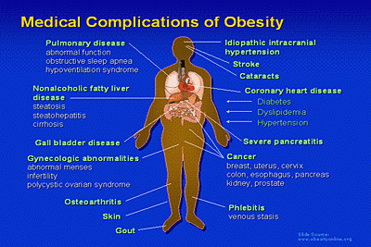

Slide 20
Americans’ Food Practices are Shifting Dramatically
Reduced frequency of family meals
Increased fast food consumption
Increased portion size
Increased consumption of soft drinks
Restrained eating, meal skipping
Notes:
Americans’ food practices are shifting dramatically:
Reduced frequency of family meals
Increased fast food consumption
Increased portion size
Increased consumption of soft drinks – from 27 to 44 gallons per year from 1972 to 1992
Restrained eating, meal skipping
Increased food products in supermarkets – about 30,000 now

Slide 21
Abnormal cells multiply out of control and spread into surrounding tissues and other body parts. Cancer is the 2nd leading cause of death in the US.

Slide 22
Benign / Malignant / Metastasized
Benign is non-cancerous, not harmful, and unable to spread
Malignant is cancerous, is harmful, and ready to spread to other parts of the body.
Metastasized cancer has moved from one part of the body to the other and starts new growth just like the original, and spreading.

Slide 23
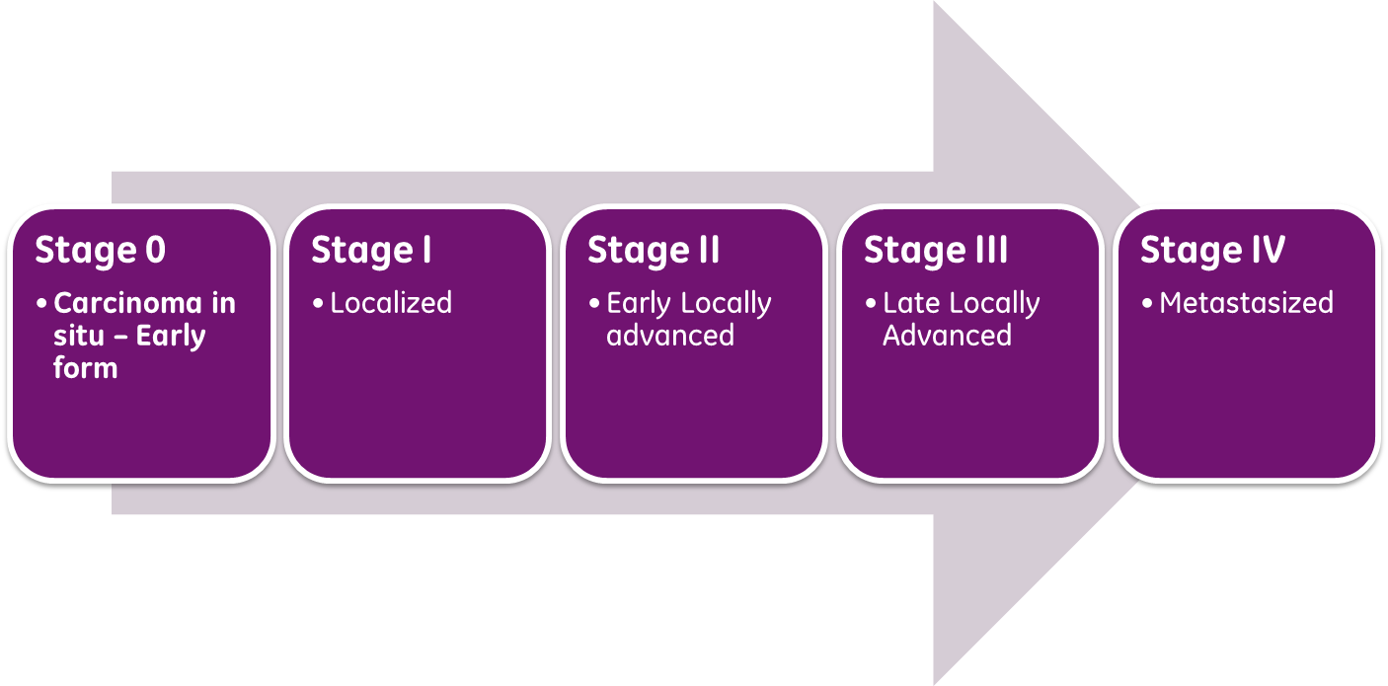
STAGES of CANCER Stages of Cancer Stage 1: Small & contained within the organ Stage 2: Has not started to spread into surrounding tissue, tumor is larger than in stage, & could have spread in the lymph nodes close to the tumor (this depends on type of cancer) Stage 3: Cancer is larger & may have started to spread into surrounding tissues Also, there are cancer cells in the lymph nodes. Stage 4: Has spread from where it started to another body organ. Sometimes doctors use letters A, B or C to further divide the number categories – for example, stage 3B cervical cancer.

Slide 24
The four different classes cancer can be assigned to:
Lymphomas- immune system organs
Leukemia's- blood-forming organs
Carcinomas- glands and body lining (skin, digestive tract)
Sarcomas- connective tissues (bones, ligaments, and muscles)

Slide 25
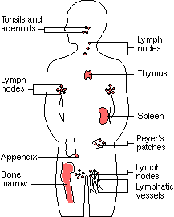
Immune System

Slide 26
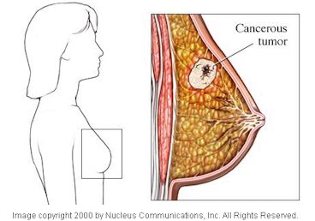
Breast Cancer: Sarcoma

Slide 27
This little girl has Leukemia

Slide 28
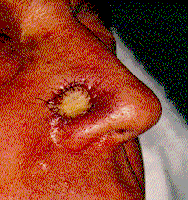
Skin Cancer: Carcinoma

Slide 29
Skin Cancer Facts
It’s highly curable with early detection.
Cancer risk is just as high in tanning beds as in the sun.
Melanin-is the pigment in dark-skinned individuals that protect them against UV damage
SPF of 30 or higher is recommended

Slide 30
How does Cancer develop?
Exposure to a carcinogen
Entry of a carcinogen into the body
Change of cells genetic material
Out-of-control multiplication of the cells
Tumor formation

Slide 31
Cancer Risks You Can Control:
1) Tobacco Use
2) Alcohol Abuse
3) Poor Physical Activity

Slide 32
CAUTIONS
Change in bowel or bladder habits
A sore that does not heal
Unusual bleeding or discharge
Thickening or lump that suddenly appears anywhere
Indigestion or difficulty swallowing
Obvious change in a wart or mole
Nagging cough or hoarseness
Sudden weight loss

Slide 33
Cancer Treatments
Chemotherapy
Radiation Therapy
Targeted Therapy
IOther Procedures and Techniques
Stem Cell Transplant
Hyperthermia
Photodynamic Therapy
Blood Product Donation and Transfusion
Lasers in Cancer Treatment
Immunotherapy

Slide 34
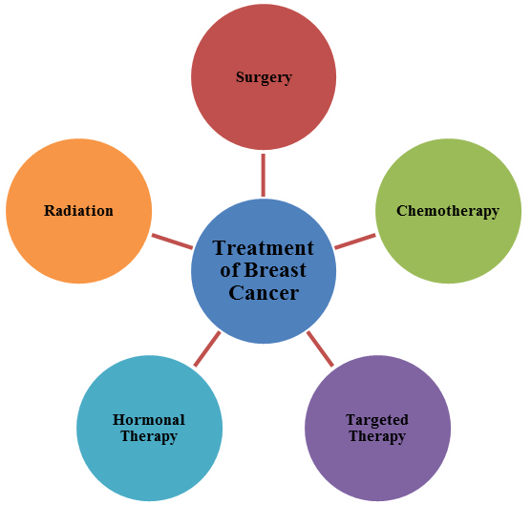
Cancer Treatments
Treatments
Other Procedures / Techniques
Surgery
Chemotherapy
Radiation Therapy
Targeted Therapy
Immunotherapy
Stem Cell Transplant
Hyperthermia
Photodynamic Therapy
Blood Product Donation and Transfusion
Lasers in Cancer Treatment

Slide 35
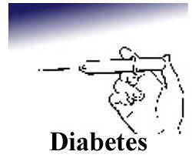

Slide 36
Diabetes
Diabetes is a condition of abnormal use of glucose, usually caused by too little insulin or lack of response to insulin.

Slide 37
Diabetes Facts
The 6th leading cause of death in the U.S.
Leading cause of blindness in the U.S.
Contributes greatly to heart disease.
Type 2 accounts for 80% of the cases, and most often affects those individuals middle age and older.
Type 2 is recently on the rise in children.
$245 billion spent annually on Diabetes
American Diabetes Foundation

Slide 38
Type 1 Type 2
Usually sets in during adulthood, but is now prevalent in children
Pancreas makes enough or too much insulin
Insulin shots generally not required, but other drugs may be of help
Body fatness
Most preventableLifestyle related
Usually sets in during childhood or adolescence with no controlling factors
Pancreas makes too little or no insulin
Insulin shots required
Low to average body fatness

Slide 39
The pancreas performs 2 main functions:
To produce digestive juices, which aid digestion.
To produce the hormone insulin, which controls blood glucose.
Considered to be in both the digestive and hormonal systems.

Slide 40
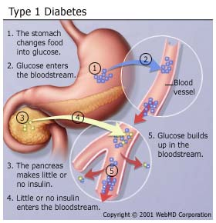

Slide 41
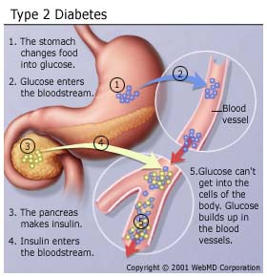

Slide 42
The Dangers of Diabetes….
Diabetic Coma- a loss of consciousness due to uncontrolled diabetes and the resulting buildup of toxic ketones in the blood.
Ketones- fragments formed by the tissues during incomplete use of fat for energy, and released into the blood.
Insulin Shock- the result of too much insulin, which causes a dangerous drop in blood glucose. Also called hypoglycemia.

Slide 43
Early Symptoms of Diabetes
Craving sweets
Frequent thirst
Slow healing cuts
Frequent urination
Blurred vision
Itchy skin
Hunger
Fatigue

Slide 44
Possible long-term effects of Type 2 Diabetes.
Impaired circulation
Disease of the feet and legs that often leads to amputation
Kidney disease that often requires hospital care or kidney transplant
Impaired vision or blindness due to cataracts and damaged retinas.
Nerve damage
Skin damage
Strokes and heart attacks

